Slide 1

License Attribution / Use
This work is licensed under a [Creative Commons Attribution 4.0 International License][cc-by].
Use or Adaption of this work requires attribution to the FinOps Foundation under the ccby4.0 license.
You are free to:
Share — copy and redistribute the material in any medium or format
Adapt — remix, transform, and build upon the material for any purpose, even commercially.
Under the following terms:
Attribution — You must give appropriate credit, provide a link to the license, and indicate if changes were made.
More details can be found at https://www.finops.org/introduction/how-to-use/

Slide 2
Advancing the people who do cloud financial management
FinOps.org

Slide 3



Cloud is critical to every business but is a fundamentally different consumption model...
Decentralized
Variable
Scalable
Engineers siloed from Finance (and Procurement) are empowered to commit the company to spend
Variable cloud spend replacing data center/fixed cost spend
Instant access to resources enables innovation but often results in overprovisioning
Notes:
Cloud is critical to success by bringing The new cloud economy has us facing some new realities in the IT world:
Traditional procurement silos have broken down, buying is decentralized, and it’s only getting more so
Cloud adoption, once the purview of CTOs and the location of science-fair projects now represents MATERIAL and substantial costs for many companies, and it’s only growing
What you buy in the cloud is variable, it changes month to month, day to day, minute to minute. It’s not predictable, and it’s hard to forecast well using traditional methods. And with over 1M Cloud SKUs out there, it’s only getting more complex.
In a cloud world of vast supply, plentiful options and few constraints on your spending, inefficiency is inevitable. But all businesses must focus on efficiency, and need the information to create it. Further, macroeconomic pressures – elections, Brexit, and the coming economic downturn (eventually there will be one) – require even more ruthless efficiency measures.
Inefficiency becomes a target on IT’s back (very important) in a downturn.
Luckily, there’s also a new operating model for the cloud to help address these realities.

Slide 4
FinOps is an evolving cloud financial management discipline and cultural practice that:
enables organizations to get maximum business value
by helping technology, finance and business teams
to collaborate on data-driven spending decisions
Collaborate at FinOps.org
Notes:
FinOps is an evolving public cloud management discipline that
Uses best practices and cultural change to
Engage technology, finance and product teams
To collaborate on data-driven spending decisions
That align the whole organization to achieve maximum business value
By matching public cloud spending to actual customer demand
Throughout the entire IT lifecycle
This is just rewriting, it’s probably fine as is until we can have an official summit to wrangle it some more.
Definition of FinOps Spend 4 minutes
For many organizations, FinOps, is the new operating model for the Cloud.
FinOps is the practice of bringing technology, business and finance together to master the unit economics of cloud for competitive advantage.
It brings financial accountability to the variable spend model of cloud.
Read the bullets
FinOps. Is a prescriptive model of actions, best practices and culture
Enabling DevOps, Finance and Business teams
To make decisions that increase business value
Highlight competitive advantage. Velocity is the new currency. Low performance can directly impact the top and bottom line. Competitors are doing this and trying to put you out of business.
Prescriptive set of processes THAT HAVE TO BE DONE CONTINUALLY
Systems/Actions
Best practices
Culture
Culture of accountability
Getting product, finance and business teams to collaborate
Make real-time decisions related to tradeoffs between cost and speed
That drive decisions that increase business value
Improve efficiency and better align costs to business needs
Better forecasting of cloud costs.
In the same way DevOps allowed IT to speed up to meet business demand
FinOps allows Finance and the Business to work together with IT at speed and at scale

Slide 5
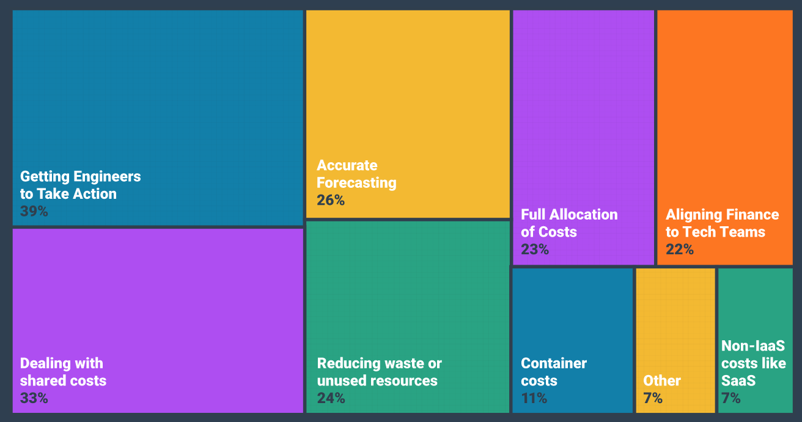
Data.FinOps.Org: what are your top challenges?
Use of this work requires attribution to the FinOps Foundation under the ccby4.0 license
Notes:
Getting engineers to take action on cost optimization” is the clear winner here-- it’s a challenge all FinOps teams seem to face. Other big challenges include allocating shared and unallocated costs, forecasting variable spend, aligning tech and finance teams, reporting on container costs, and reducing waste.

Slide 6


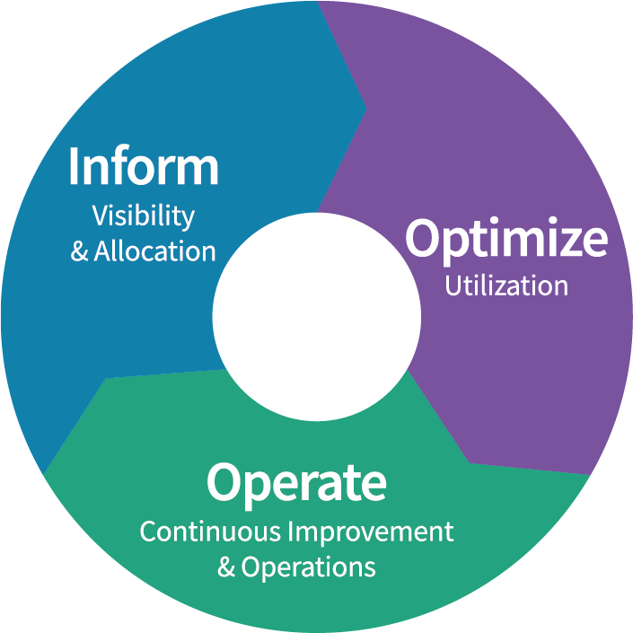





FinOps
Framework
FinOps is an evolving cloud financial management discipline and cultural practice that enables organizations to get maximum business value by helping engineering, finance & business teams to collaborate on data-driven spending decision
Maturity
Crawl
Walk
Run
Principles
Personas
Phases
Teams need to collaborate
Everyone takes ownership for their cloud usage
A centralized team drives FinOps
Reports should be accessible and timely
Decisions are driven by business value of cloud
Take advantage of the variable cost model of the cloud
FinOps Practitioner
Executive
Rates
& Usage
Business/Product Owner
Finance/Procurement
Engineering/Operations
Domains
Understanding Cloud Usage and Cost
Performance Tracking & Benchmarking
Real-Time Decision Making
Cloud Rate Optimization
Cloud Usage Optimization
Organizational Alignment
Notes:
The FinOps Framework describes the
Principles that drive our FinOps practices
The Personas that FinOps must support as stakeholders
The best practices and process models that allow us to accomplish this
And the Domains of activity we will have to perform in our FinOps practice
You May have heard the Framework called the FinOps Capability Model, or the FinOps Function model previously.
Updated beginning in Fall 2021, will continue to be modified as time goes on, but is largely stable as of January 2022.
FinOps practitioners will perform activities in each of these domains as they build a FinOps team and drive the cultural change that FinOps brings into their organizations.
There are Capabilities within each Domain that describe the detailed activities that a

Slide 7




Advancing the people who do cloud financial management
Central community for learning FinOps through virtual events, meetups, slack and other channels
Career development of practitioners through training and certification
Open standards and best practices through the FinOps.org Framework
FinOps.org

Slide 8
Addendum

Slide 9
We are a Linux Foundation Program
Governing Board
Technical Advisory Council
Practitioner Community
Marketing Committee
Special Interest Groups
End User
SIGs and
User Groups
Fund and manage the budget
Marketing and strategic direction
Elected & premier members
~10 top FinOps experts
Defines standards
Elected individuals
Real world practitioners
Connect and grow community
Share learnings and stories

Slide 10














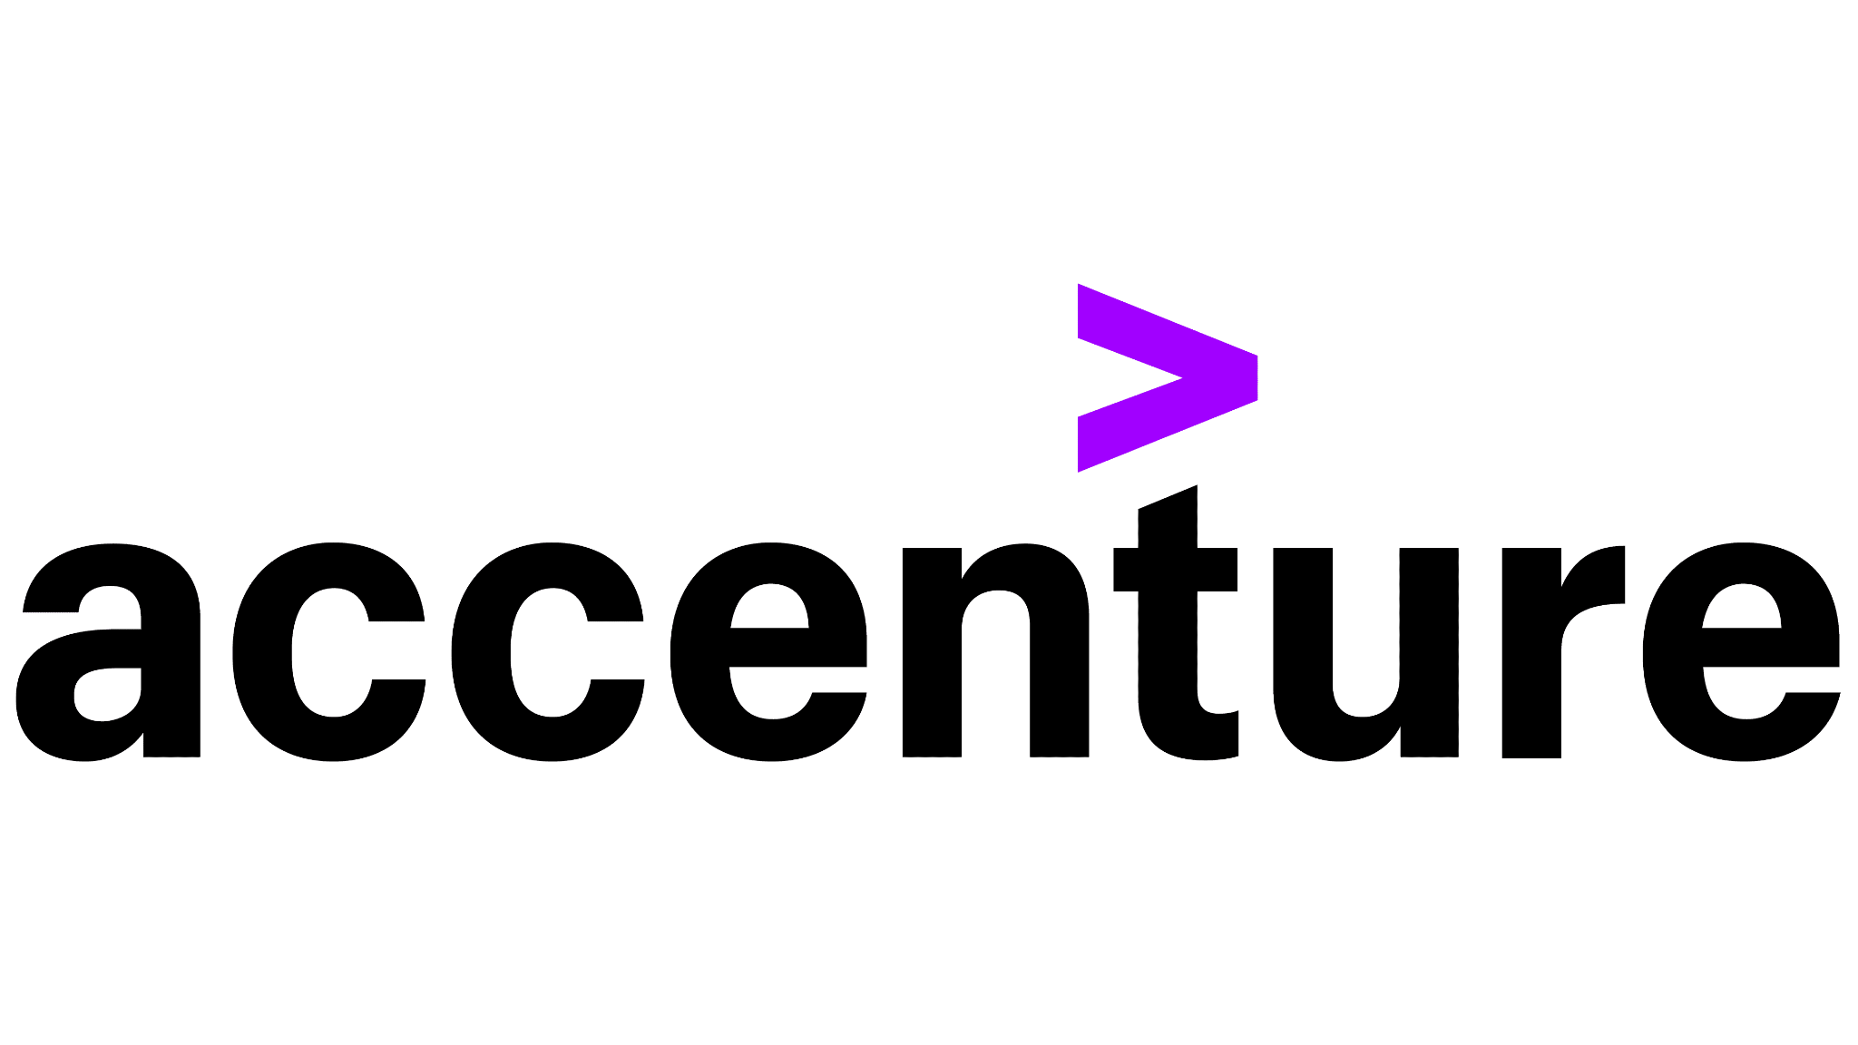









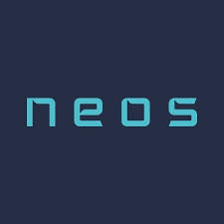

















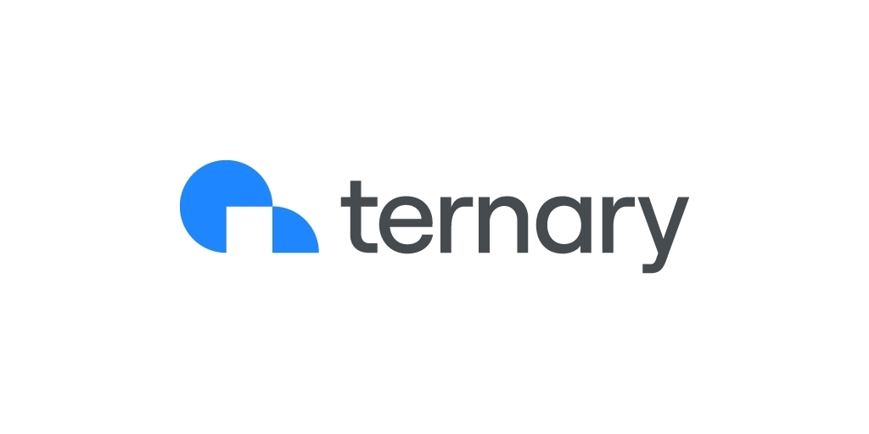



The Finops
Community
1000+
5300+
18
47
Certifications
Members
Working Groups and SIGs
Vendor Members
Premier
General
Notes:
Add Certifications to this

Slide 11
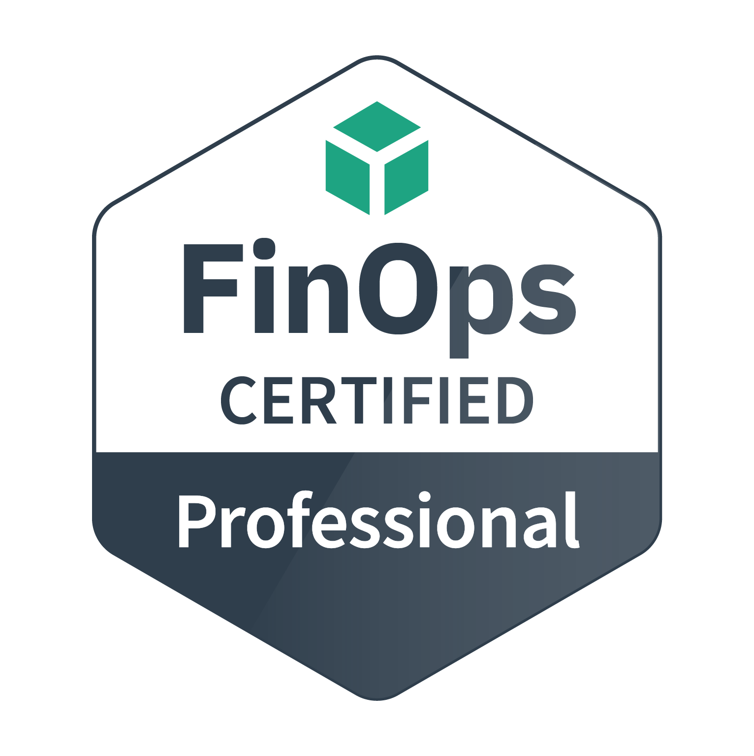
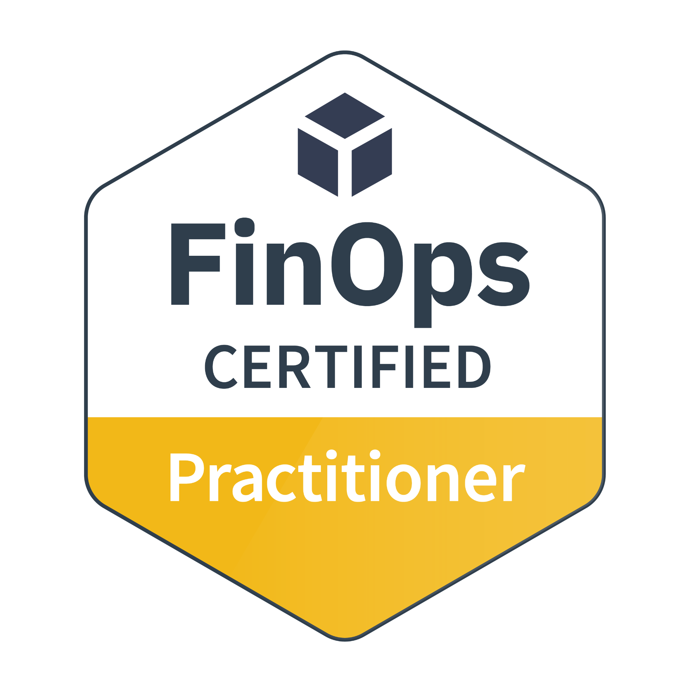
Training and Certification
Certification Track for FinOps practitioners and consultants
FinOps Certified Practitioner
FinOps Certified Professional
Persona-based Training for stakeholders working with FinOps teams
Individual courses for Engineers, Finance, Executives, Procurement and Product
Go to FinOps.org/certification
77% share on LinkedIn* *Source: October 2021 Credly.com Badge Share Data
Notes:
Our funding comes from two primary sources: 1) is Training/Certification.
There’s the FOCP now and also FOFE. FOFA is in development as well as persona based trainings for Finance/Execs/etc.

Slide 12
FinOpsverse
Slack
Community
Summits
FinOps.org
Framework
Training
& Certification
Vendor
Certification
Working
Groups
State of
FinOps
Regional
Meetups
Notes:
Importance by Size, Color by Status, Practitioner could be green (1500-4000 this year but want to accelerate).
Cert: need to get more of community certified, drive more through our lists, and leverage more of LF's massive 10 figure training business
Standards: metrics aren’t set.
Vendor members doing well.

Slide 13
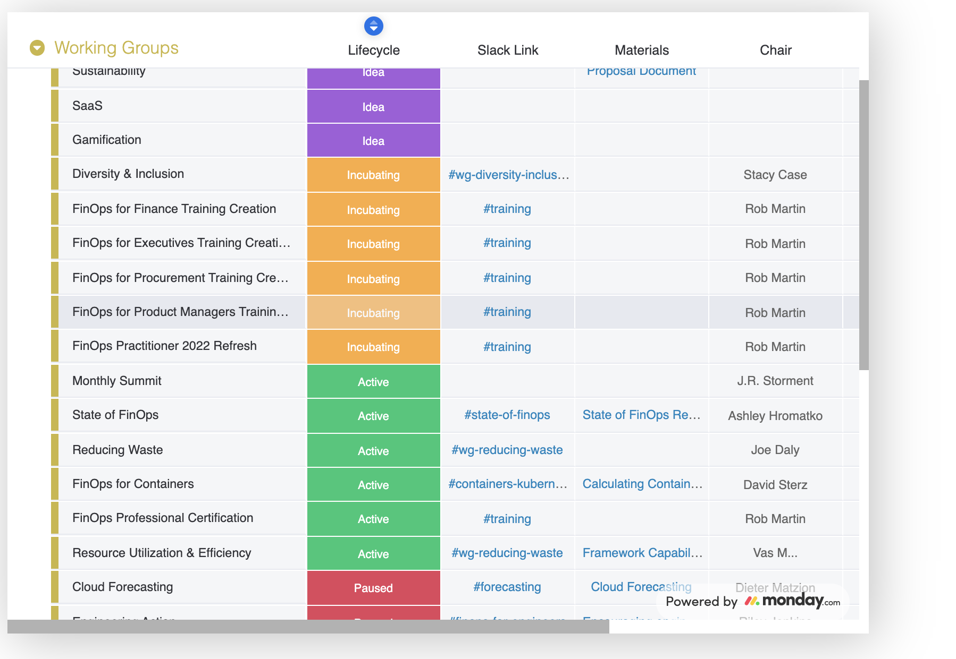
Contribute to Working Groups
Practitioner Working Groups (WG) create best practices and standards, supported by vendor members.
Special Interest Groups (SIG) create community and benchmarking.
These feed into the FinOps Framework and output Projects.
See Current Groups

Slide 14
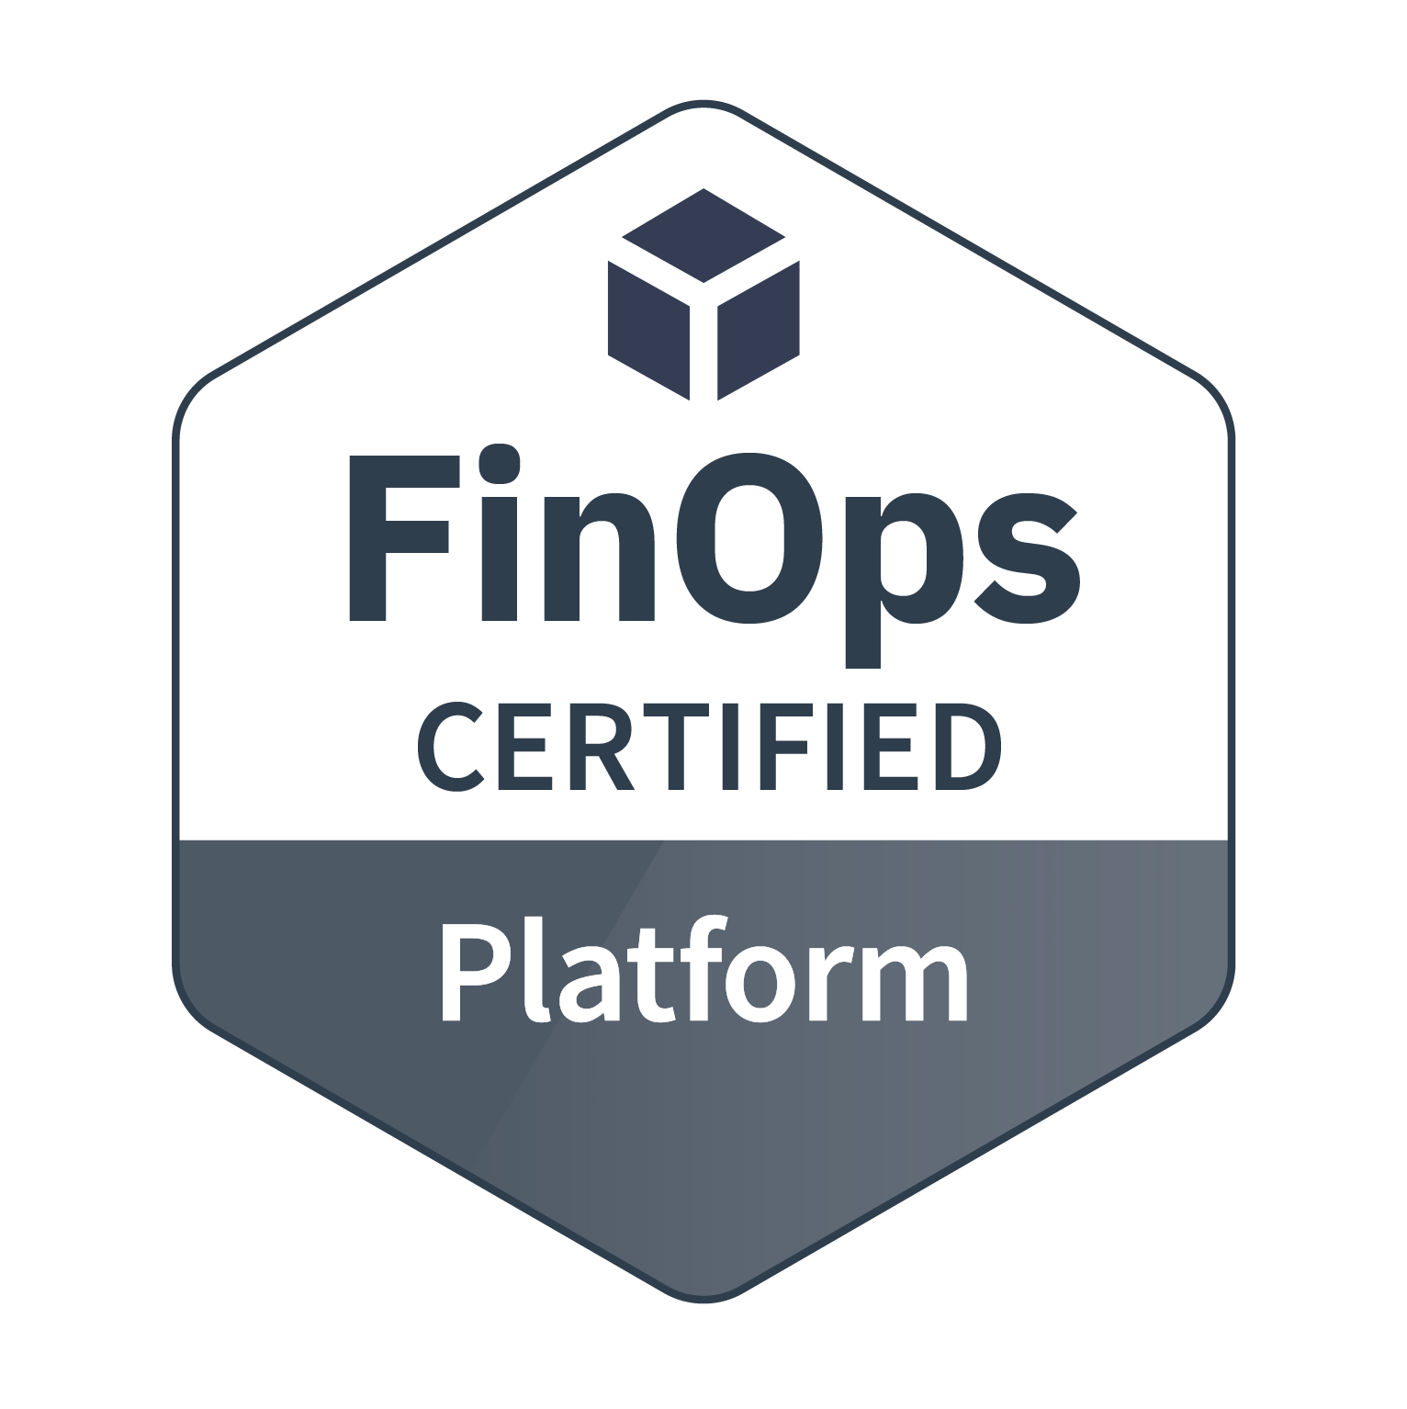
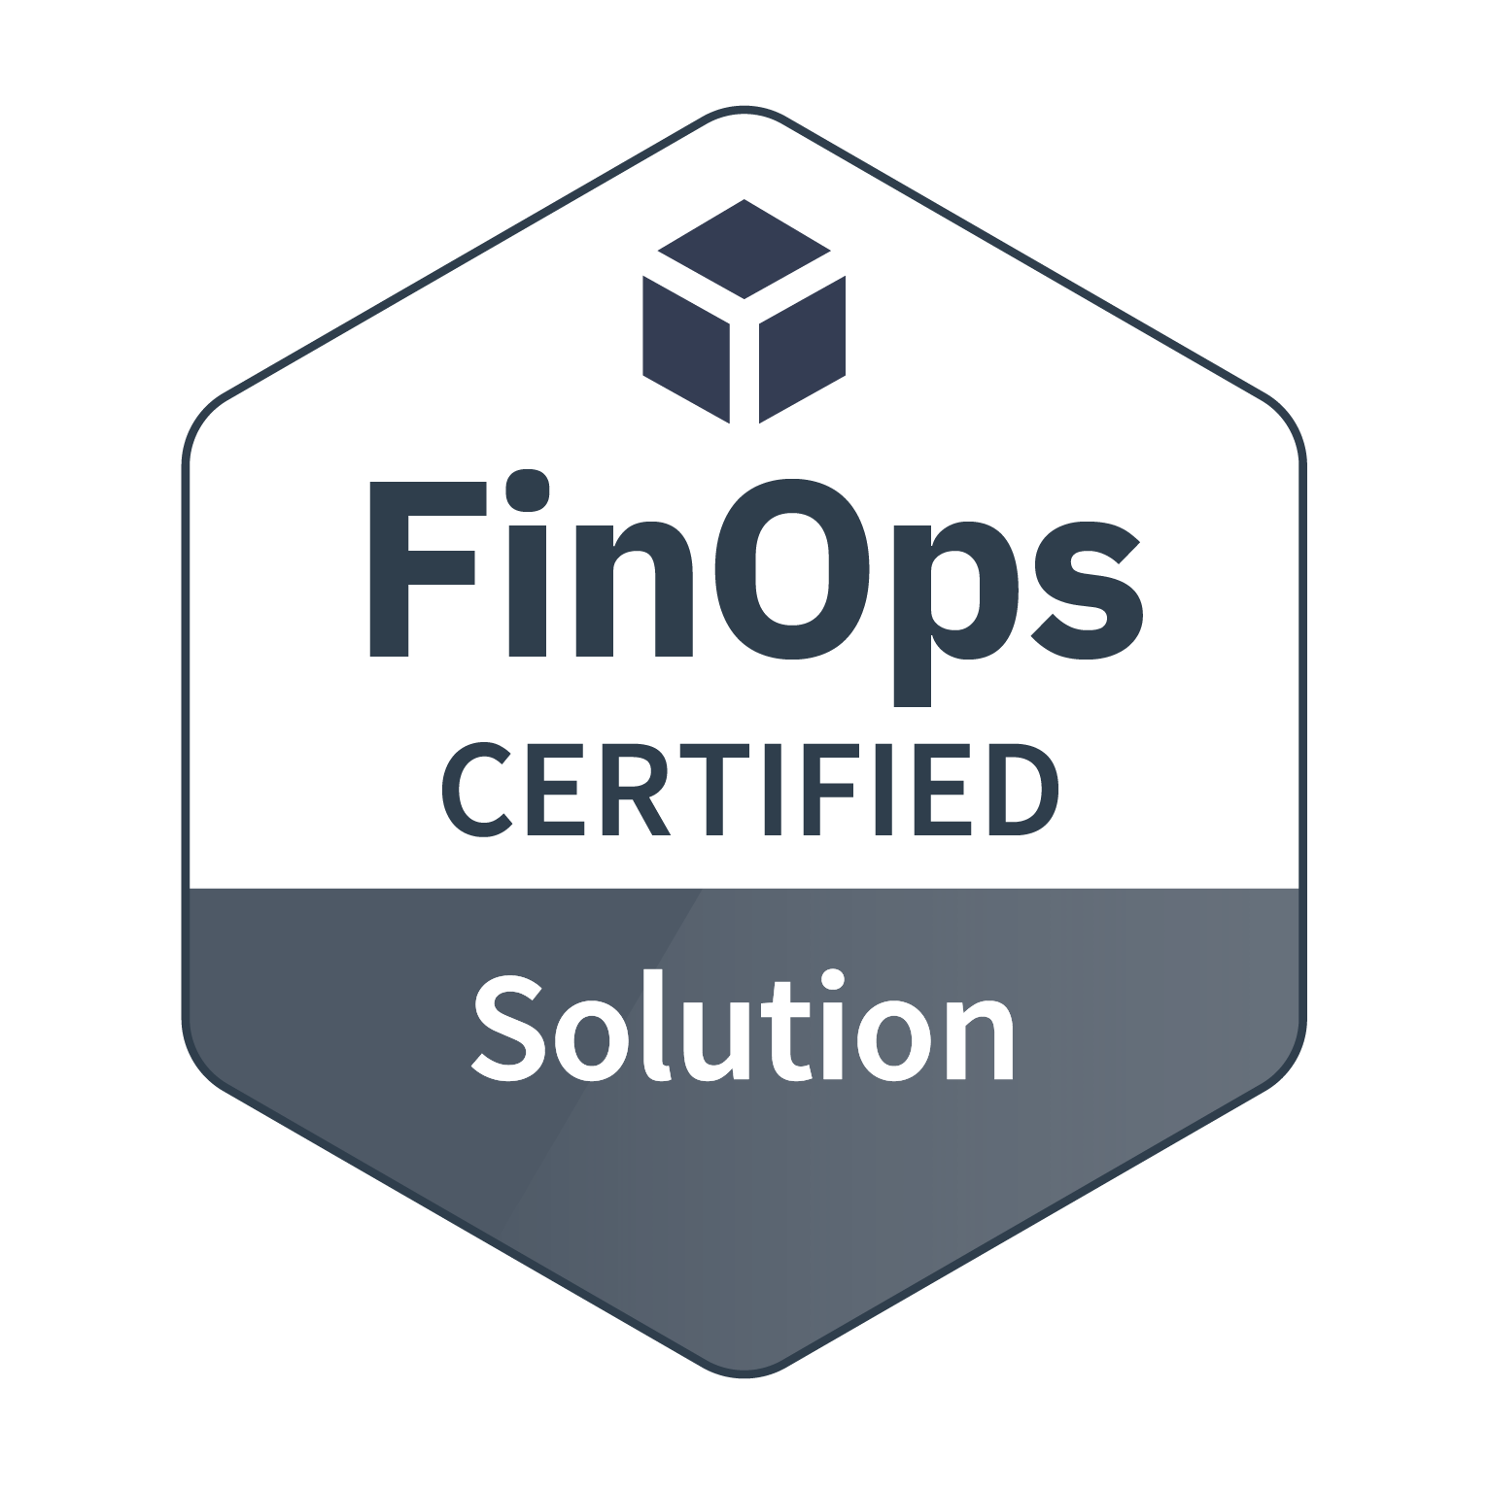
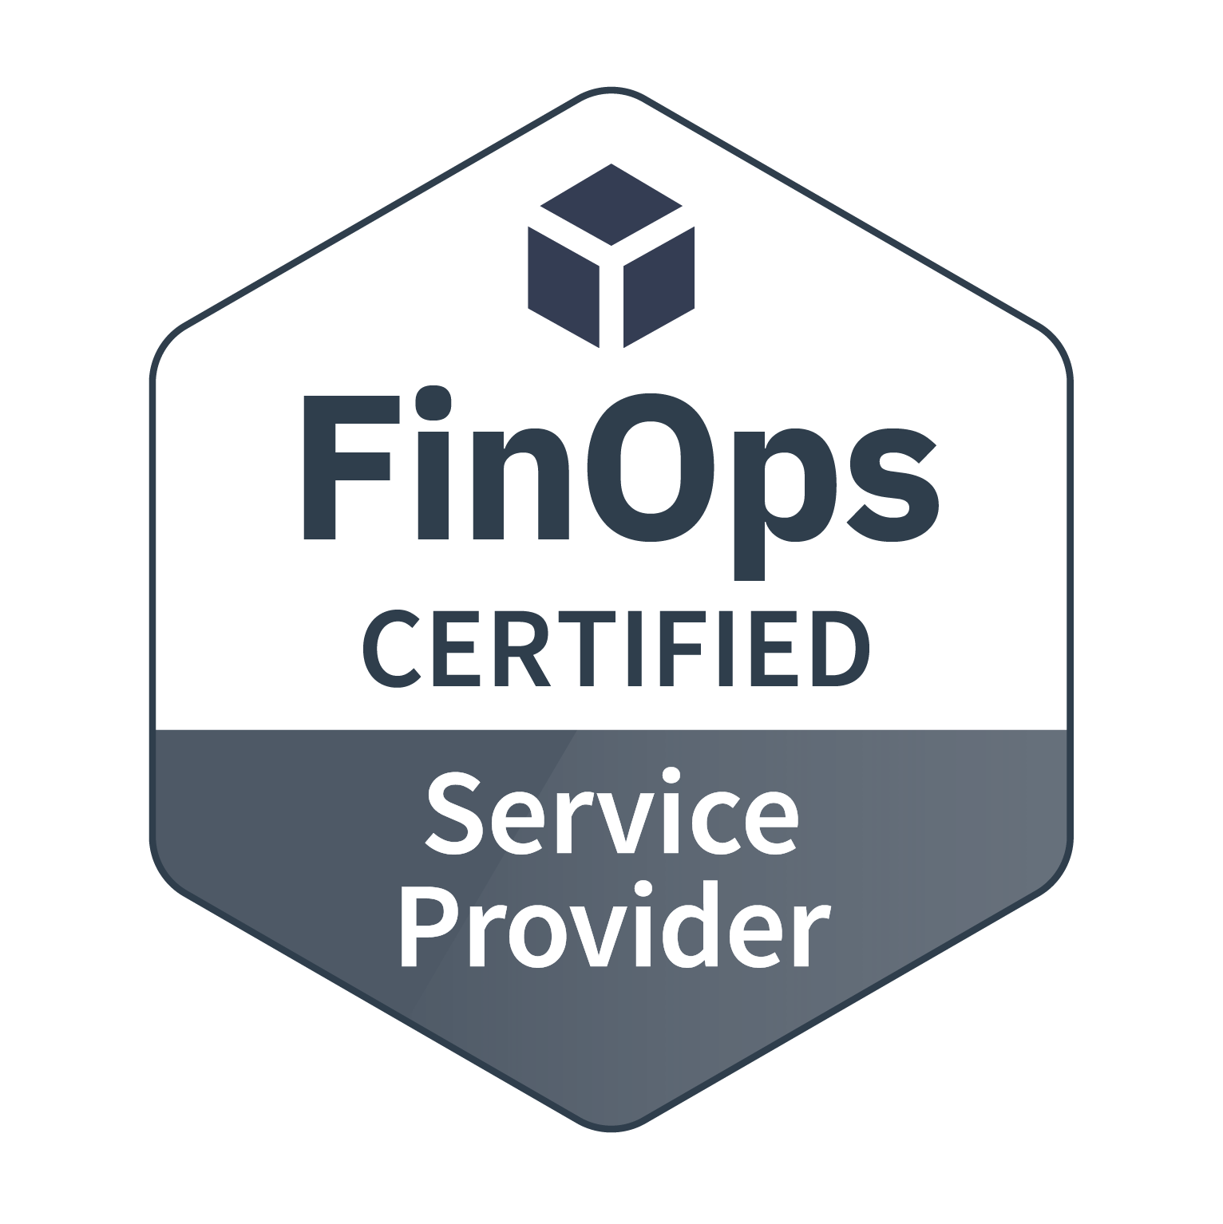
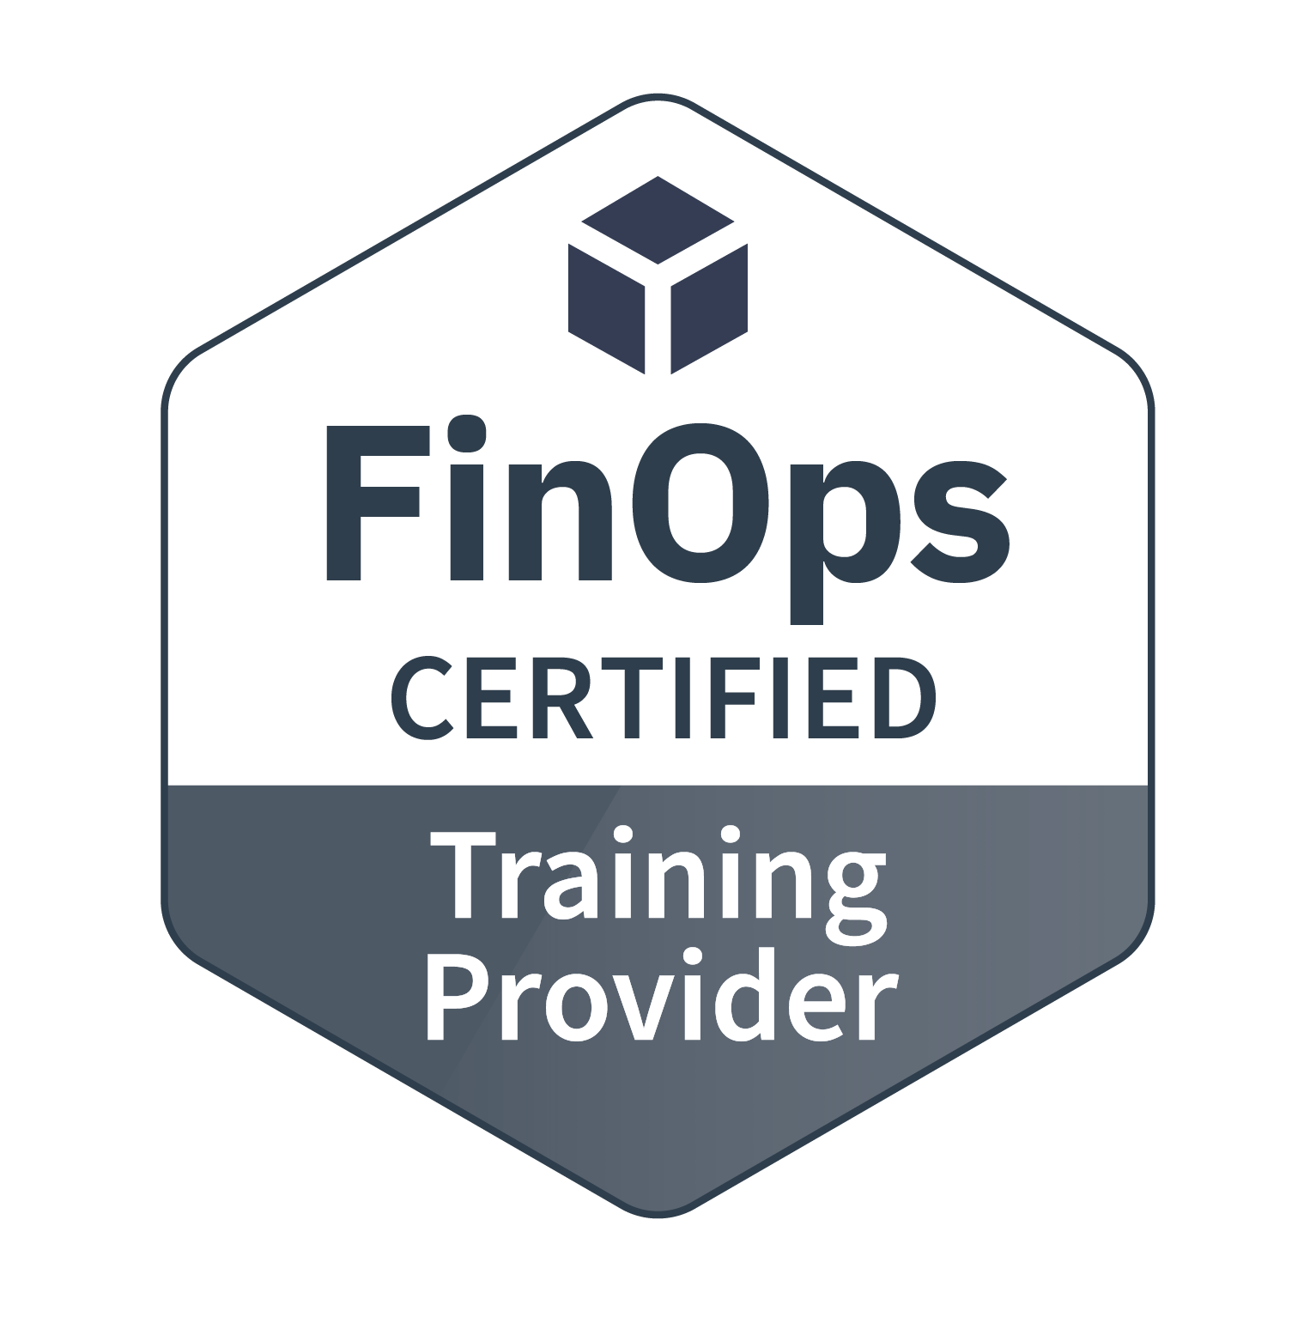
Vendor Certifications
Technology providers that license and deliver a software product to help people successfully adopt cloud financial management practices aligned with the FinOps standards.
Providers that deliver solutions that contain a subset of the functionality found in the Certified Platforms which solve a specific part of a cloud cost management challenge.
FinOps experienced professional service providers that consult with enterprises about cloud financial management and help their clients with best practices.
Vetted training providers who have deep experience in cloud financial management training.
View details and requirements

Slide 15
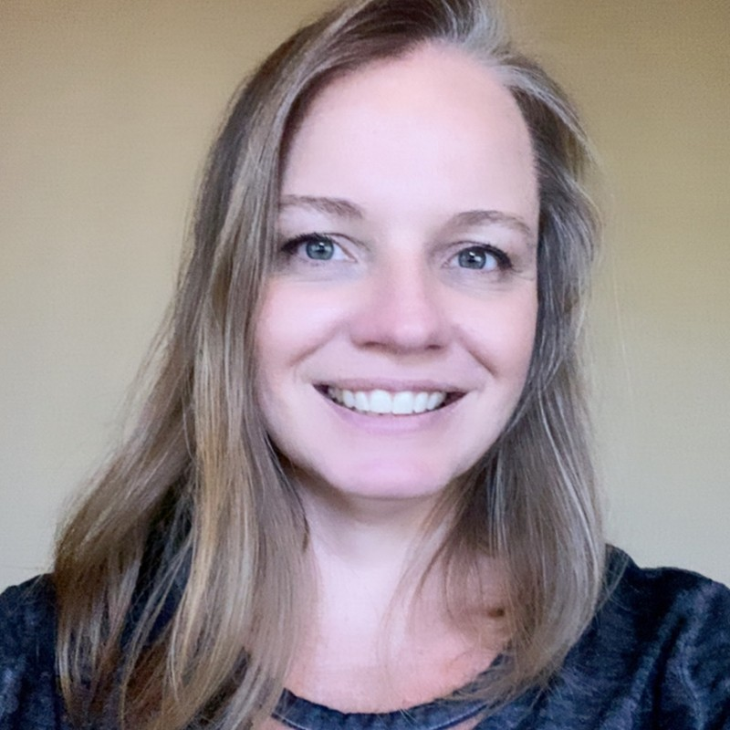
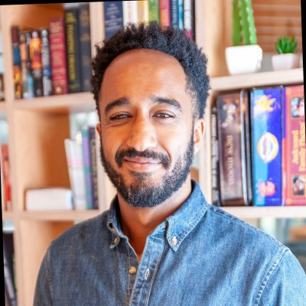
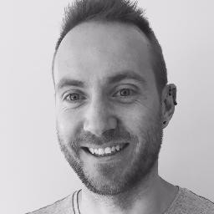
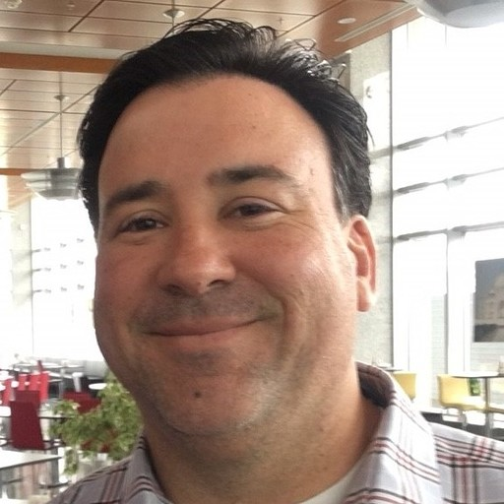
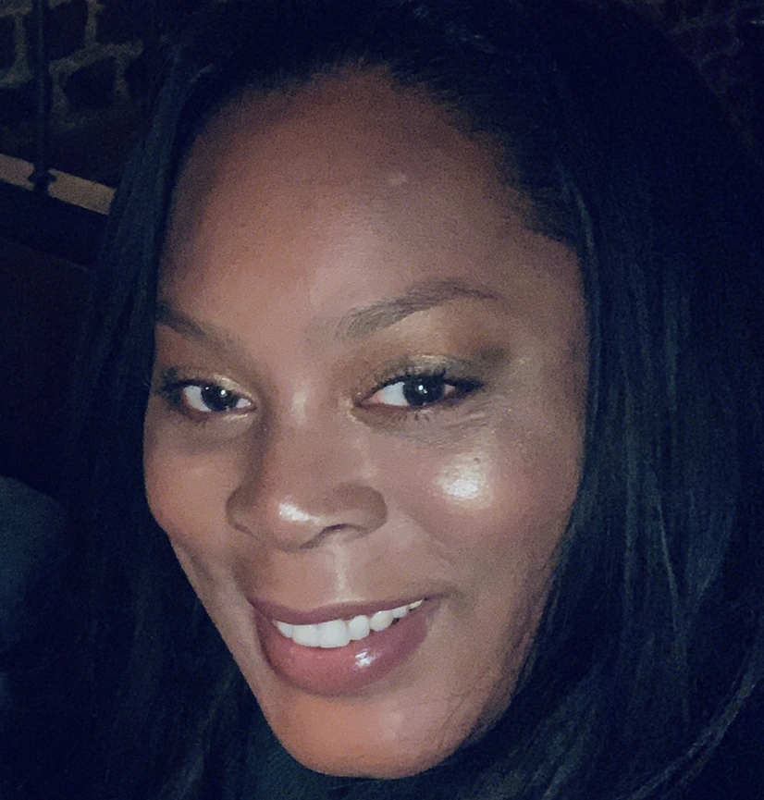

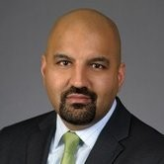
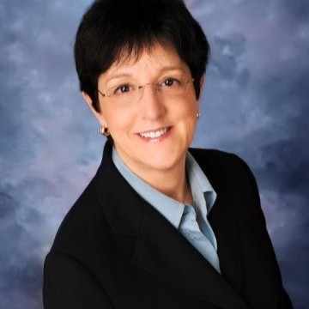
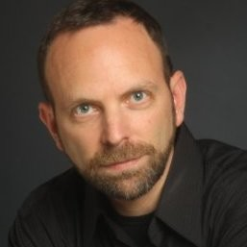
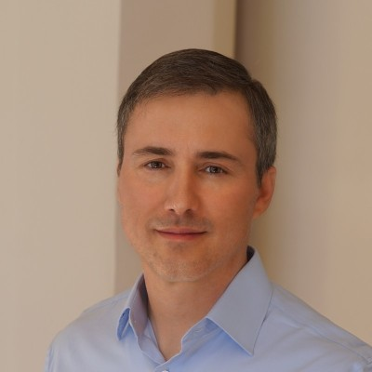
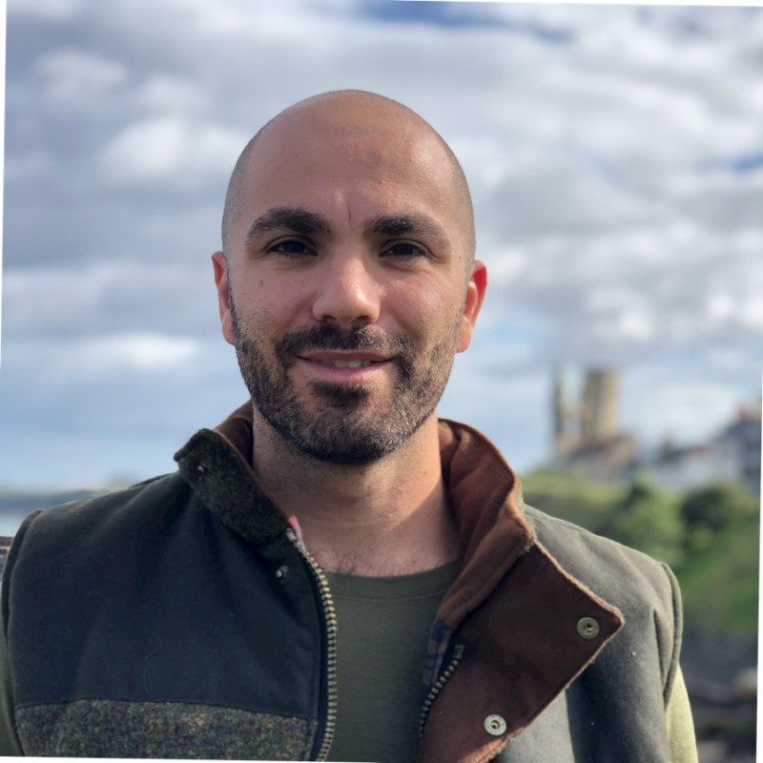
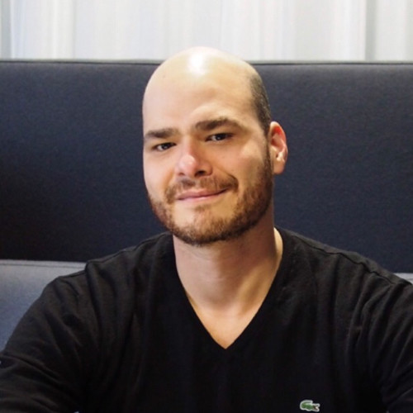
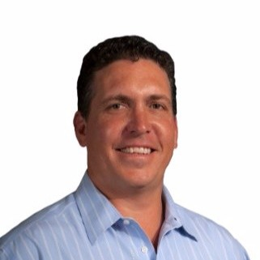


FinOps Governing Board is made up of practitioners, clouds, and technology leaders who drive strategy
Chair
Jennifer Hays
Fidelity Investments
Abuna Demoz
Google
Mike Fuller
Atlassian
Scott Linn
Chevron
Natalie Daley
HSBC
Miles Ward
SADA
Rakinder Sembhi
Deloitte
Deb MacCallum
VMware Cloudhealth
Mike Eisenstein
Accenture
Michael Kearns
Virtasant
Eugene Khvostov
Apptio Cloudability
Fernando Herrara
IBM Nordcloud
Bailey Caldwell McKinsey
Mark Shan Tencent
Darrel Sackett SoftwareONE

Slide 16

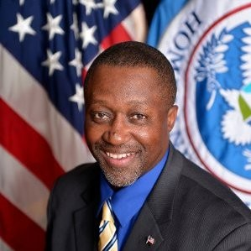

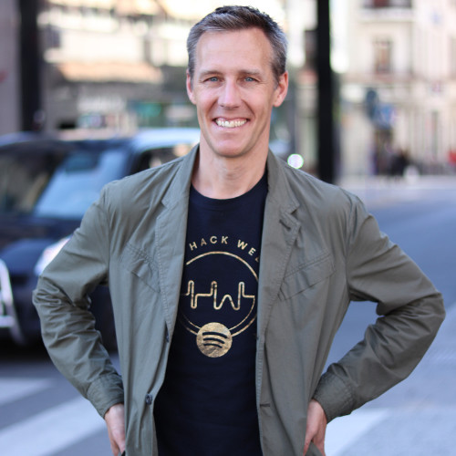
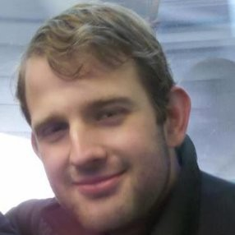
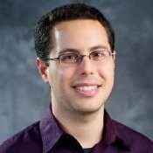
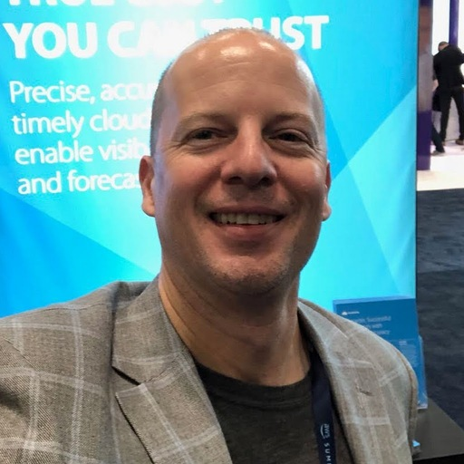
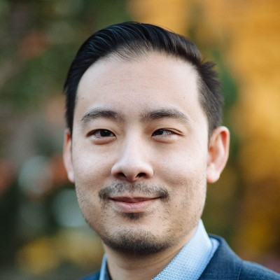
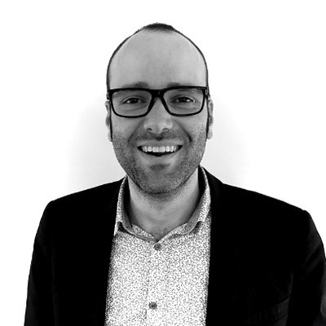

The Technical Advisory Council drives best practices
Chair
TAC Liaison
Mike Fuller
Atlassian
Vas Markanastasakis FinOps Foundation
Melvin Brown
US Gov OPM
Riley Jenkins
DOMO
Anders Hagman Spotify
John McLoughlin
Cloudhealth VMware
Open
Amitai Rottem
Google
Rich Hoyer
SADA
Jeremy Ung
Apptio Cloudability
Antoine Lagier
FinOps.world
Next Elections Slated for Q1

